Slide 1
Candidate Statement: Structure and Preparation
Office of Academic Affairs
Willie Miller, Faculty Advancement and Leadership Development Fellow
IUPUI

Slide 2
Rachel Applegate, Assistant Vice Chancellor for Faculty Affairs
Special thanks to

Slide 3
Agenda
Part I: Key steps
Part II: Structure of a Candidate Statement
Part III: Special areas of emphasis
Part IV: Style notes

Slide 4
Key Steps
Step 1: Questions to ask yourself to begin with
Step 2 Writing
Outline (main sections)
Just write (your life themes)
Get AI to help
Step 3: Review (get others to help)
Step 4: Completeness
Step 5: Polish

Slide 5
Step 1: Questions to ask yourself to begin with
Why do I do what I do?
How do I do what I do?
What are some concrete things I can point to that show what I do?
What are my signature accomplishments?
Can I group my CV into themes? (not necessarily ALL of it.)
How do I explain myself to non-academics?
How do I introduce myself at conferences?
What motivates me?
How is this reflected in the items on my CV?

Slide 6
Step 2a: Design an Outline
Step 2: Writing
Use Candidate Statement Template
Adjust for your:
Faculty type (tenure track, clinical, lecturer, research, librarian)
Rank sought (associate, full; senior/teaching professor)
Within your main area of excellence, identify:
Key themes
Pieces of evidence (CV entries and other documentation)
Summarize:
You have met the overall criteria
You have a future

Slide 7
Step 2b: Just Write
Step 2: Writing
I am ….
I do this….
Because I ….
Now that you know (I have told you) Z, X, and Y, you will agree I meet the criteria

Slide 8
Step 2c: Get AI to help
Step 2: Writing
There are many AI-enabled tools that can help you to consider how you might present your work.
Ask an AI tool like Chat GPT: Write a candidate statement for someone in your field going for promotion to your next rank.
Review how the tool framed a case and consider how you may emulate elements of that framing for your own statement.
Important Note: An AI tool does not know the specifics of your career or the dept/school/campus criteria. As a result, an completely AI-generated candidate statement will not be sufficient for your dossier.

Slide 9
Step 2: Writing
Wow, this is too short
Add details, descriptions, and “for examples.”
Include not just the ‘what’ but the ‘why’
What led up to your signature accomplishments?
Wow, this is too long
See where you can condense into summary sentences
Remove examples [move to the rest of the dossier]
Keep the focus on signature accomplishments
Make the ‘future plans’ part coherent with the past accomplishments

Slide 10
Step 3: Review
Get to at least this step before coming to the hands-on workshop
What do you have?
Don’t worry if it is too long or too short. During Step 4, you will adjust for length.
What sense does it make?
Are there themes? How do the themes relate to each other? Is there a balance between representing how much work you have done (lots of stuff) and focusing on signature accomplishments? What is the importance of what you have done?
What does someone else make of it?
At this point, it’s useful to have someone outside of your discipline read it. You want something that is understandable to outsiders. Later you can have someone in the discipline examine it for technical correctness.

Slide 11
Consider a LIFT Mentoring Circle
Tip: lift.iupui.edu

Slide 12
Step 4: Completeness
Check the checklists
in P&T Guidelines, in Candidate Statement Template
Go through dept, school, campus criteria: do you explicitly name/claim them?
Highlight where you have mentioned key elements for substantiation: student/peer input for teaching, forms of dissemination for research, scholarly and non-scholarly impact.
How do these support your areas of excellence and themes?
Does the organizational framework still make sense? Is one theme too weak?
What are your readers saying? Does someone in your department/discipline think it is compelling? Strong science, teaching, service?

Slide 13
Step 5: Polish
Is the final product smooth and coherent?
Read it aloud for editing errors (where one section gets moved and some wording ends up wrong)
Highlights easily seen
Check acronyms or technical language; explain/expand at least once
Check details against the CV: are all references and summaries consistent?
Did you number your citations? (or hyperlink?)
Are you counting #s of articles, presentations, grants?
Check against rest of dossier: are you ready to supply details and substantiation?
Proofread; ask someone else to proofread.
Typos are potholes: they aren’t usually damaging but they interrupt the flow

Slide 14
Part II: Structure of a Candidate Statement
½ to 1 page
3-4 pages
Introduction
Who you are
What you are applying for
Area of excellence
Main focus and themes; philosophy if applicable
Signature items
Impact
Comparison to criteria
Future plans
Satisfactory area/s
Evidence of solid performance
Summary: distinctive impact
Future plans
1 page
1 page

Slide 15
Part III: Special areas of emphasis
Area of excellence
Signature items
Work in rank
Reputation, trajectory, impact
Independence

Slide 16
Area of excellence
Third Year Review | Final Review
Should be settled by the end of the third (or fourth) year review If you are uncertain, draft multiple statements, with different areas | Must be definite Cannot be chosen or determined by anybody OTHER THAN the candidate Must be clear to the reader About 2/3rds of final product will be about this area Integrative DEI case: holistic, not separated Balanced-Binned: use equal space for each area

Slide 17
Signature items
Third Year Review | Final Review
Have at least one since starting at IUPUI Others may be projects you are currently working on | Three to five specific items Multiple articles can be threaded together to lead up to key items All of those specific items must be in-rank. Most should be work completed at IUPUI Previous work can be mentioned as leading up to the signature items

Slide 18
Signature items, trajectory, reputation
Signature items must have been accomplished in rank.
They may not have had much time to attract formal scholarly citations.
Your reputation may be best demonstrated and documented by:
Work prior to rank—this has had time to acquire citations and other uses.
When you use work from earlier in your career, describe how it created a foundation for current work.
Media/non-scholarly uses of the work
Invitations to speak on your work

Slide 19
Independence
Write in the first person singular.
For multiple-author and multiple-investigator projects, be clear about what your role is.
What did you uniquely contribute to those projects?
From P&T Guidelines:
Candidates should make clear to readers their independence and the impact of their work.
Candidates engaged in interdisciplinary work or team science should make every effort to represent their contribution to collaborative scholarship clearly, as well as the significance and value of any interdisciplinary approach they are pursuing. Candidates should carefully document their individual contributions within this context and should also demonstrate some level of independent research beyond the team science work.
Candidates should be careful to provide clear and sufficient information about their individual roles in collaborative projects, publications, presentation, or grants.

Slide 20
Where to document independence
Sometimes: in the CV, make small notes about your role.
In the candidate statement: describe your role in terms of your own career and accomplishments.
In the dossier, in the Research folder, “Discussion of 3-5 items”, describe role in relation to each project / stream of accomplishments.
In the appendix, include confirmation from co-authors. At least one co-author, from at least the signature items. Best practice: get documentation as you go, for everything.

Slide 21
Part IV: Style Notes
Clarifying rank sought
Examples
Who I am
My research
Addressing criteria
Clarification of details
Discipline-specific metrics

Slide 22
Who I am
To engage in social justice, community-engaged work means aligning my values and actions. To walk the talk as a scholar means to be who I am authentically while calling out inequities, particularly involving those who have been historically marginalized. Cristina Santamaria Graff pt Balanced
My background provides context for my technology-focused in-rank research activities. While working as a clinical social worker in the field of mental health, several transformative experiences…I became discouraged with the pervasive practice of separately targeting signs and symptoms for management with multiple medications…. David Wilkerson pt Research

Slide 23
Examples
Ayoung Yoon, LIS/INFO, research area of excellence
Defining terms
“Over the past decade, my research has focused on data curation, which is the long-term management of data to ensure optimum use and reuse throughout its lifecycle. Data is crucial to historical or longitudinal inquiry… My main focus is on the behaviors of persons who reuse data”.
Why it is important
What my particular contribution is

Slide 24
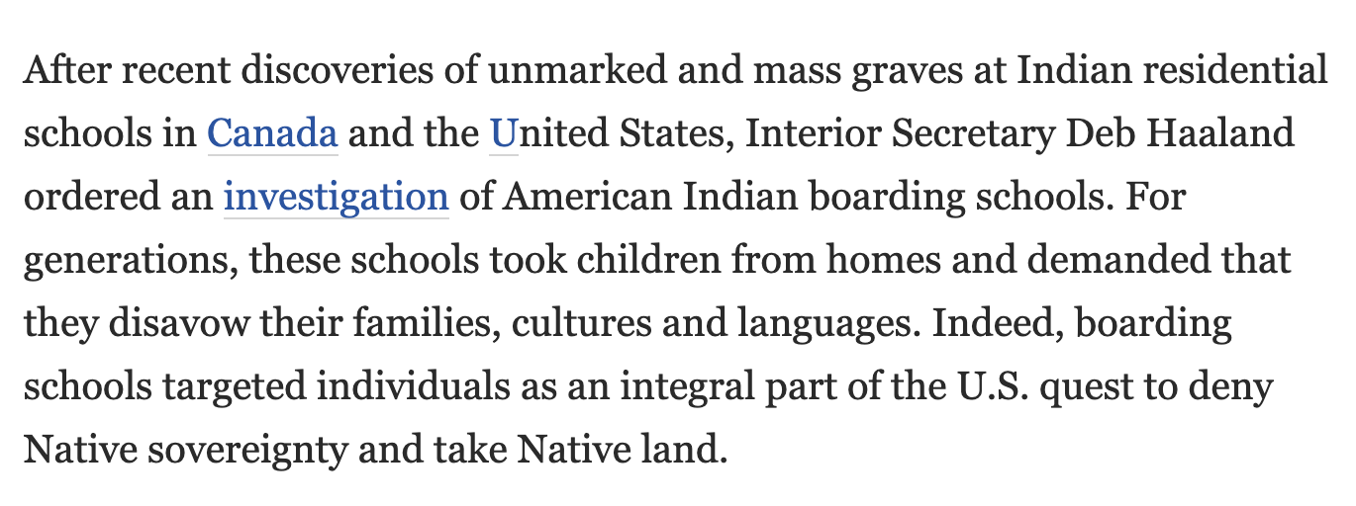
Side-bar: just the science?
“Culturally responsive teaching [and mentoring] recognizes, affirms, and values students’ cultures and their unique experiences.” “The greatest single motivator for these [diverse STEM doctoral students] was a desire to help others.” Ebony Omotola McGee, Black, Brown, Bruised
It is appropriate to talk about who YOU are and WHY you do what you do.

Slide 25
Addressing criteria
I have achieved excellence in support of teaching and learning by building two learning communities that train other faculty. Additionally, I have achieved what the IUPUI Promotion and Tenure Guidelines refer to as “curricular development excellence” by disseminating my ideas on learning communities through nine peer-reviewed conference presentations. Nancy Goldfarb, teaching professor
In each section, “According to the SOE criteria”. Cristina Santamaria Graff

Slide 26
Clarification of details
At IUPUI a themed learning community (TLC) consists of two general education courses and a first-year seminar integrated by a common theme. Nancy Goldfarb, teaching professor
Family caregiving is accompanied by significant [Wilkerson]
Family as faculty from Santamaria Graff

Slide 27
Discipline-specific metrics
[Fellowship training program director] Over the past seven years we have ensured no citations were listed for the vascular surgery program. Raghu Motaganahalli, full clinical
I care about student success….I closely monitor DFW rates and seek ways to reduce them. Below is a chart showing DFW rate drops for courses taught or mentored exclusively by me. Lingma Lu teaching professor
I take satisfaction that all the graduating fellows that I trained have found positions in well-known private and academic practices throughout the country. Juan Tejada, associate clinical
Because of my contributions to the field, I was recently invited to the March 2020 invitation only Workshop on Knowledge Infrastructure…a broad, interdisciplinary discussion. Ayoung Yoon, pt research

Slide 28
A template, an example
Template
Example (entirely fake)
Annotated example (still fake)
Samples (real!)

Slide 29
Thank you!
Willie Miller
wmmiller@iupui.edu
Rachel Applegate
rapplega@iupui.edu

